Slide 1
Auto Decisioning – BI Analyst Forum
October 2017

Slide 2
Applications – Comparison & Decisioning
Applicant 1
Applicant 2
 | Camry
Loan-to-Value Ratio of Car | 105%
Car Payment-to-Income Ratio | 9%
Current Balance to Credit | 14%
Trades with 90Days Delinquency | No Info.
Trades with 60Days Delinquency | 1
Derogatory Public Records | 0
 | Lexus
Loan-to-Value Ratio of Car | 135%
Car Payment-to-Income Ratio | 18%
Current Balance to Credit | 27%
Trades with 90Days Delinquency | 0
Trades with 60Days Delinquency | No Info.
Derogatory Public Records | 0
1
2
Applicant 3
Applicant 4
 | Prius
Loan-to-Value Ratio of Car | 111%
Car Payment-to-Income Ratio | 15%
Current Balance to Credit | 65%
Trades with 90Days Delinquency | 1
Trades with 60Days Delinquency | 0
Derogatory Public Records | 0
 | Corolla
Loan-to-Value Ratio of Car | 80%
Car Payment-to-Income Ratio | 11%
Current Balance to Credit | 40%
Trades with 90Days Delinquency | 4
Trades with 60Days Delinquency | 4
Derogatory Public Records | Missing
3
4
Notes:
-Consider multiple customers coming in for their dream cars to a Toyota dealership
-Based on the characteristics of each applicant, which would you consider approving versus rejecting?
CLICK to show the circles around some of the big different characteristics
Applicant 1 – Looks very standard other than 1 instance of a 60Days delinquency
Applicant 2 – Wants a Lexus with an Advance Ratio of 135%! So, here itself we are looking at a case of negative equity right from the start
Applicant 3 – Has a high value of 65% on his current credits
Applicant 4 – Has a low Advance Ratio but has been delinquent multiple times for 60 days & 90 days
-So, if you were to consider each of these applications individually, what would your instinct tell you about giving loans to them?

Slide 3

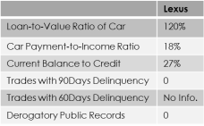



Applications – Decisioning Overview
3
1
2
3
4
1
2
3
4
Analytics
Scorecard
A
B
C
D
Risk Grades Assigned
4
Credit Portfolio
High Probability
Decision to Dealer
5
Deal Structure
Med-High Probability
Computerized Decisioning i.e. Auto Decisioning
Consistency and no biases
Algorithm developed by analyzing over a million customers
Scientific process
Considers present economic trends
What does ‘Auto Decisioning’ do?
Approval/Denial based on customer’s risk
i.e. Likelihood of customer repaying loan (risk factor)
*Always Better Service
2.1MM applications processed in FY17 – 55.9% (1.2 MM) Auto Decisioned
Fundamental building block for ‘Retail Transformation’ – a completely digital car shopping and purchase experience
Historical Performance
Medium Probability
Risk Appetite
Low Probability
1
2
Notes:
-What happens in Auto Decisioning is as follows:
Step 1: We have a sophisticated data analytics procedure that studies hundreds of thousands, even millions, of similar applicants and is used to create multiple scorecards
Step 2: Scorecards are developed based on the Portfolio Data Analytics
Step 3: Each applicant’s information is processed through the scorecard which calculates the likelihood of each applicant repaying the loan
Step 4 & 5: Risk Grades (a.k.a Credit Grades) are assigned to each applicant and the final decision is passed on to the dealer
-Thus, while you may have thought that Applicants #3 & #4 should have been rejected, we process them to objectively understand their risk and accordingly approve/reject them. In this case, all the applicants were approved with different risk grades (and hence different interest rates)
CLICK to advance text about Computerized Decisioning & explain from slide
CLICK to advance text about what Auto Decisioning does & explain from slide
CLICK to advance text about Computerized Decisioning & explain from slide

Slide 4
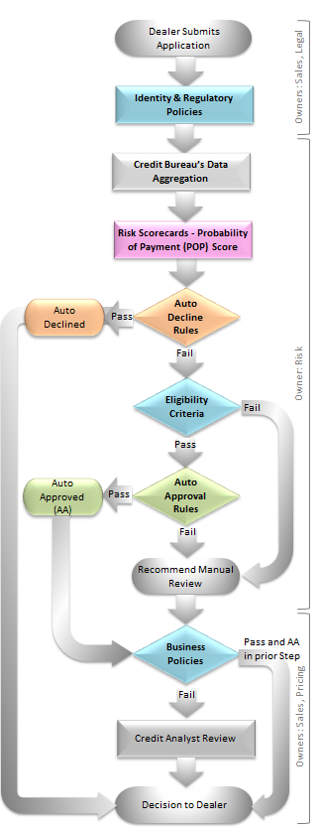
Conceptual Process Flow
Process | System | Key Observations
Application submitted to TFS | RouteOne | System used by dealers for submitting customer’s application
Identity & Regulatory Policies | carLOS | Application that fails any verification is not eligible for Auto Approval
Credit Bureau’s Data Aggregation | Attribute Tool Box | Computes values that are used by Risk scorecards
Scorecards | SMG3 | SMG3: TFS Risk’s Decision Engine
Auto-Decline Rules | SMG3 | Each exclusive rule is a combination of Collateral, Type of Loan, Payment Probability, Score and Deal Structure
Eligibility Criteria | SMG3 | Checks Identity, Legal, and Risk parameters
Auto-Approval Rules | SMG3 | Each rule is a combination of Payment Probability, Deal Structure and Credit Profile Information
Recommend Manual Review | SMG3 | Application sent to queue for manual review by credit analyst
Business Policies | carLOS | Application’s credit structure checked for alignment with TFS’s business policies related to Collateral, Term, Advance Limits
Credit Analyst Review | DSSOs | Manual review by Credit Analyst (CA)
Decision to Dealer | RouteOne | Auto Declined; OR Auto Approved; OR Manual Decision

Slide 5
Scorecard Overview
FY17Q3

Slide 6
Scorecard Overview
Acquisition scorecards compute the applicants’ Probability of Payment (POP) score
Tool to assess consumer’s credit worthiness
Reduce delinquency and loss by reducing the approval of high-risk applicants
Assist in development of Auto-decisioning strategies
Variables used in segmentation of Scorecards
Product Type
Months on bureau file
No. of open trades
Applicant Age
New/Used/Certified Vehicle
Vehicle Make - TLS/NTL
Application Term

Slide 7
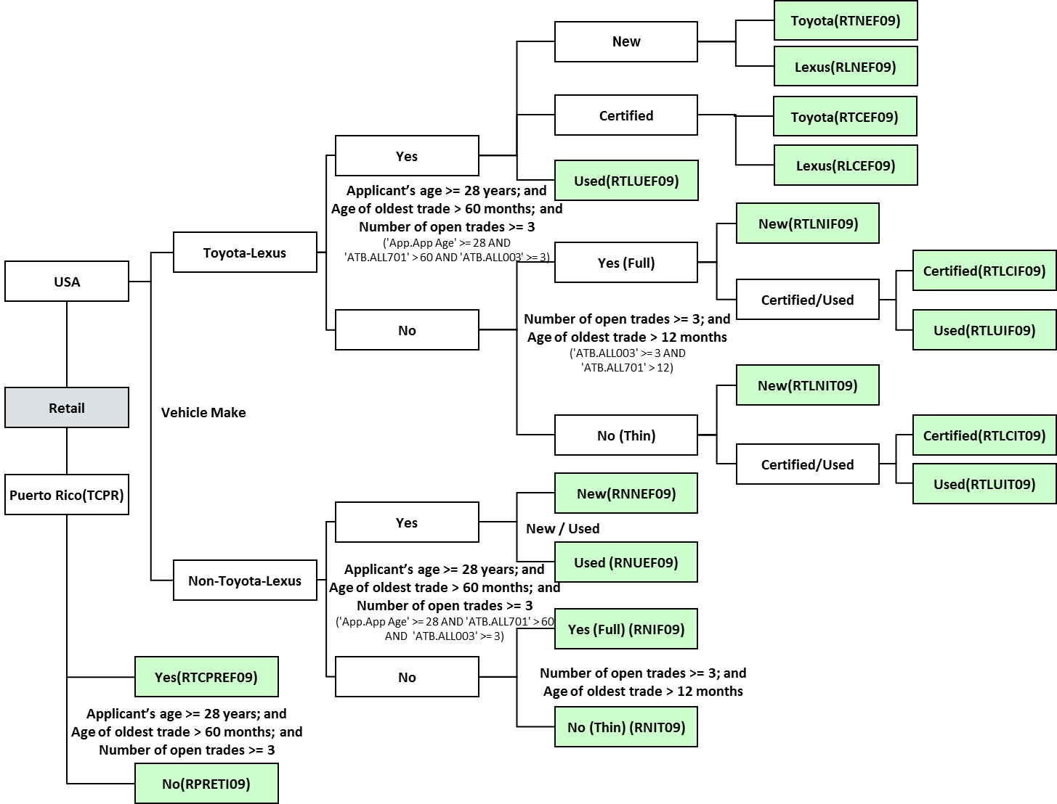
Scorecards - Retail

Slide 8
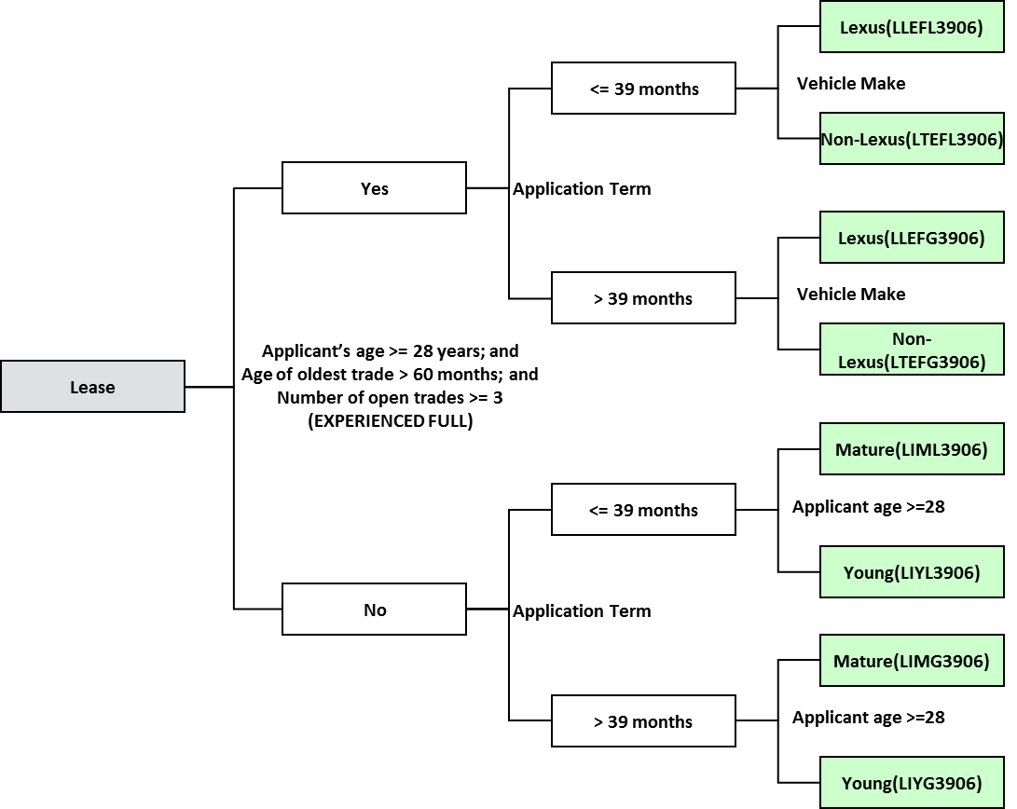
Scorecards - Lease

Slide 9
Scorecards Variables
Credit Bureau Characteristics
Trades with status 90+ in last 2 years
Ratio of current balance to high credit on revolving trades
No. of inquiries in last 1 year /6 months
Ratio of satisfactory to total trades
Months on bureau file
No. of derogatory public records
Trades with status 60 in last 1 year
No. of currently past due trades
Months since recent 30/60 delinquency
Primary Bureau FICO Score
No. of consumer financial inquiries
No. of captive financial inquiries
No. of open consumer financial trades
No. of open bank revolving trades
Type of Credit - No Hit /Inquiries only
No. of bank cards
Ratio of balance to limit on bank cards
No. of satisfactory trades
Applicant Characteristics
Applicant Education Level
Type of House
Months at Current Job
Existing Good Account with TFS
Months at Current Residence
Deal Structure Characteristics
Ratio of Monthly Payment to Income
Percent Advanced
Application Term
Total Debt to Income Ratio
Vehicle Make

Slide 10
Scorecard Input Variables
Primary RIDE tables for scorecard inputs:
APPL_FACT_REST_VW – Deal Structure Information
APPL_APP_DEMO_PRFL_REST_VW – Applicant Information
BUREAU_MAST_DIM_REST_VW – Credit Bureau Information
 | RIDE Table | RIDE Fields
Deal Structure information | APPL_FACT_REST_VW | AP_PAYMENT_TO_INCOME_RATIO
 | APPL_FACT_REST_VW | AP_PERCENT_ADVANCED_RATIO
 | APPL_FACT_REST_VW | AP_DEBT_TO_INCOME_RATIO
 | APPL_FACT_REST_VW | AP_TERM
Applicant Information | APPL_FACT_REST_VW | AP_CUST_TIME_AT_CURR_EMPL
 | APPL_APP_DEMO_PRFL_REST_VW | AP_CUST_RESIDENCE_CD
 | APPL_APP_DEMO_PRFL_REST_VW | AP_CUST_OCCUPATION_CD
 | APPL_APP_DEMO_PRFL_REST_VW | AP_APPL_EDUCATION_CD
Credit Bureau Information | APPL_FACT_REST_VW | OVERALL_PRIM_BUR_SCORE
 | BUREAU_MAST_DIM_REST_VW | BPCR_CURRENT_PAST_DUE
 | BUREAU_MAST_DIM_REST_VW | BPCR_NO_INQ_12MTHS
 | BUREAU_MAST_DIM_REST_VW | BPCR_REVOLV_DEBT_RATIO
 | BUREAU_MAST_DIM_REST_VW | BPCR_NEW_TRADES
 | BUREAU_MAST_DIM_REST_VW | BPCR_NUMBER_BANK_CARDS
CONFIDENTIAL – INTERNAL USE ONLY

Slide 11
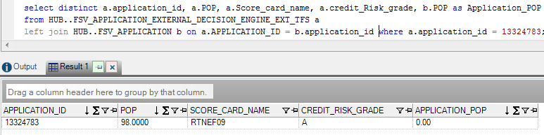
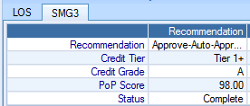
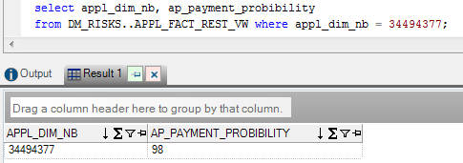
Scorecard Output – Probability of Payment
TFS scorecards are run in SMG3, so the results are stored in an external decision table instead of in the main Fiserv Application table.
RIDE location of Probability of Payment
CONFIDENTIAL – INTERNAL USE ONLY

Slide 12
Auto Decisioning
FY17Q3

Slide 13
Auto Decisioning
How Auto Decisioning criteria is established
Based on a holistic view of the portfolio’s performance and not just on individual deal-by-deal or dealer-by-dealer basis
Study of payment performance of numerous (hundreds of thousands to millions) contracts under different economic environments
Study of manual decisioning patterns and market (economic) conditions at the time
Criteria used in Auto Decisioning
How Auto Decisioning Works
Multiple entities and criteria
Credit Profile of Customer | Business Policies
Deal Structure | Risk Assessment of Customer to Repay
Sales, Pricing, & Fraud
Legal
Risk
Owner: Legal
System: carLOS
Regulatory requirements (OFAC, FACTA)
Owner: Risk
Systems: SMG3 & ATB
23 scorecards
Auto Decline & Auto Approval criteria
Owners: Sales, Pricing, & Fraud
Systems: carLOS & Other plug-ins
Business & Product Policies
Fraud tools/criteria
Identity verification rules
Pricing information

Slide 14
The Future Roadmap
FY17Q3
CONFIDENTIAL – INTERNAL USE ONLY

Slide 15
Building for the Future
Other
Counter
-offers
Alt. Deal Structure
Not every deal will be auto decisioned. Some exceptions will require manual work.
Mult. Apps
Phase III
Counter offer deal structure. If the initial application does not meet auto approval criteria – this is the ability to restructure the deal and offer additional deal structures that would be approved and optimized.
The ability to offer customers additional options that optimizes risk and return for the organization. This phase includes a large analytical effort and the purchase of a optimization tool to plug into the existing originations process.
TARGET
Multiple Apps Phase II
Dup Applications beyond the original, from different dealers, can’t be auto decisioned due to system limitations. This phase is to design a process and rework CarLOS to address.
Bus. Sol. Scorecard
Writing decision logic for mult. App. same dealer. Fiserv changes will be required
Foundational
Approval w/Conditions
Rebuild Scorecards
Today we do not have a business scorecard. This phase is to build and deploy two scorecards; business only and business consumer blended within SMG.
Manual
Targeted Auto Decisioning
Identity Verification Tools
The ability to send an approval with a condition to clear certain checks like address, name, phone, SS#, mismatch on low risk customers.
Develop new PD/LGD/ELL model for originations. Replace current 2012 scorecards. This is a foundation project for AD.
Current Auto Decisioning
CURRENT
Multiple Apps Phase I
Upgrade current LexisNexis Instant ID to include NAP premium which contains cell phone verification. Test and introduce waterfall to PreciseID to clear what fails LN.
Declines
Reporting Only
Refine AD segments
Increasing Auto Declines
EFFORT
CP2483
CP2483
CP2483
CP2483
CP2483
CP2483
CP2476
CP2476
Est. Completion
Dec
2015
Dec
2015
Dec
2015
Jun
2017
Aug
2017
-
-
-
TBD
TBD
Q4 FY18
Q4 FY18
TBD
TBD
Status
Complete
Complete
Complete
Complete
Complete
In
Progress
In
Progress
In
Progress
In
Progress
In
Progress
In
Progress
Foundational Components of Auto Decisioning Roadmap
ANALYTICS
TECHNOLOGY
&
INTEGRATION
SPEED
&
FLEXIBILITY
DATA CAPTURE
&
SHARING
On Track
At Risk
Flat Trend
Trending Up

Slide 16
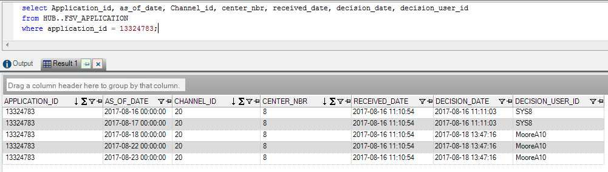
Fiserv Application Tables
All Fiserv tables in HUB have a prefix of FSV
Insight receives Fiserv data daily (Mon – Sun)
Main Application table is FSV_APPLICATION
Application tables contain multiple instances of an application
Any change to an application triggers a new record across all tables
State of the application as of end of day
CONFIDENTIAL – INTERNAL USE ONLY

Slide 17
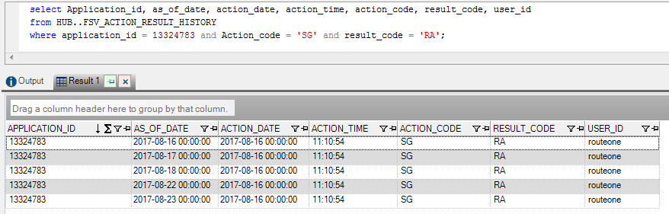
Fiserv Action History Tables
Action History tables capture the date and time all actions happen on an application.
A full set of action records is created for each instance of an application.
CONFIDENTIAL – INTERNAL USE ONLY

Slide 18
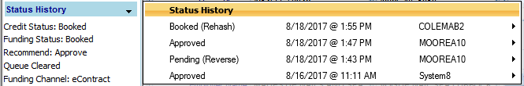
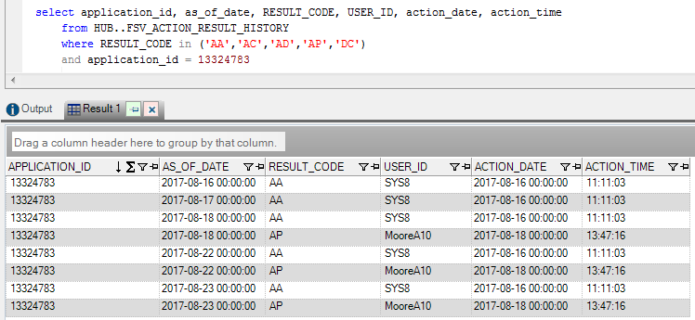
Fiserv – Application Decisions
Decisions types:
AA – Auto Approval AD – Auto Declined
AP – Approved AC – Approve Condition
DC – Declined
CONFIDENTIAL – INTERNAL USE ONLY

Slide 19
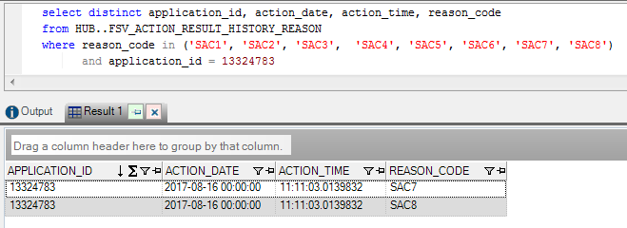
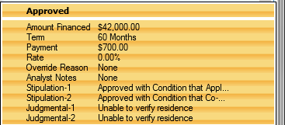
Fiserv – Stipulation Codes
Approval with Conditions Stipulation Codes
SAC1-Approved with Condition that Applicant's Submitted Social Security Number Discrepancy is resolved.
SAC2-Approved with Condition that Co-Applicant's Submitted Social Security Number Discrepancy is resolved.
SAC3-Approved with Condition that Applicant's Submitted Name Discrepancy is resolved.
SAC4-Approved with Condition that Co-Applicant's Submitted Name Discrepancy is resolved.
SAC5-Approved with Condition that Applicant's Submitted Home Phone Number Discrepancy is resolved.
SAC6-Approved with Condition that Co-Applicant's Submitted Home Phone Number Discrepancy is resolved.
SAC7-Approved with Condition that Applicant's Submitted Address Discrepancy is resolved.
SAC8-Approved with Condition that Co-Applicant's Submitted Address Discrepancy is resolved.
CONFIDENTIAL – INTERNAL USE ONLY

Slide 20
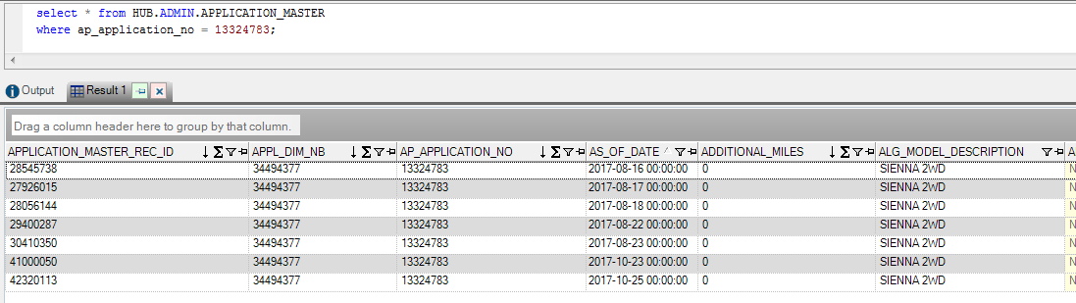
HUB – Application_Master
New Application Master is available in HUB
Contains every instance of an application
CONFIDENTIAL – INTERNAL USE ONLY

Slide 21
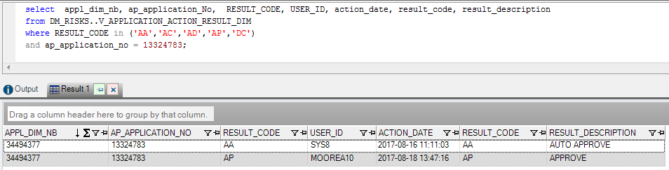
RIDE – V_Application_Action_Result_Dim
Includes only the unique records
Able to identify each decision on an application
CONFIDENTIAL – INTERNAL USE ONLY

Slide 22
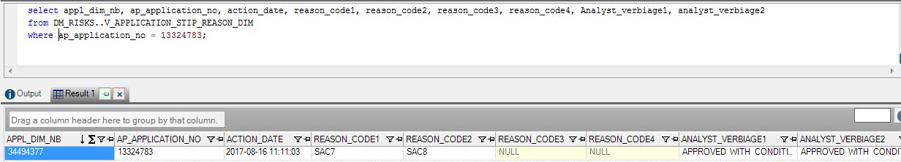
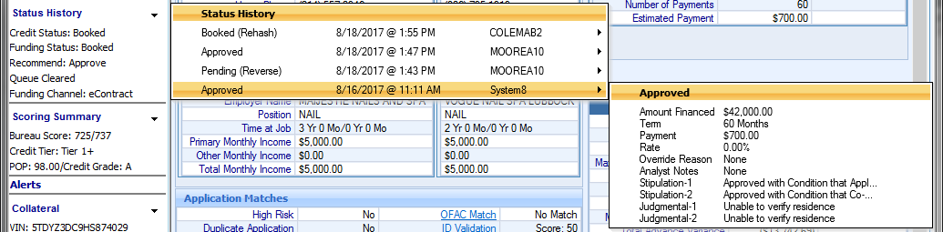
RIDE – V_Application_Stip_Reason_Dim
Includes the first 4 stipulation codes for each decision
Action Date links to the associated decision
CONFIDENTIAL – INTERNAL USE ONLY

Slide 23
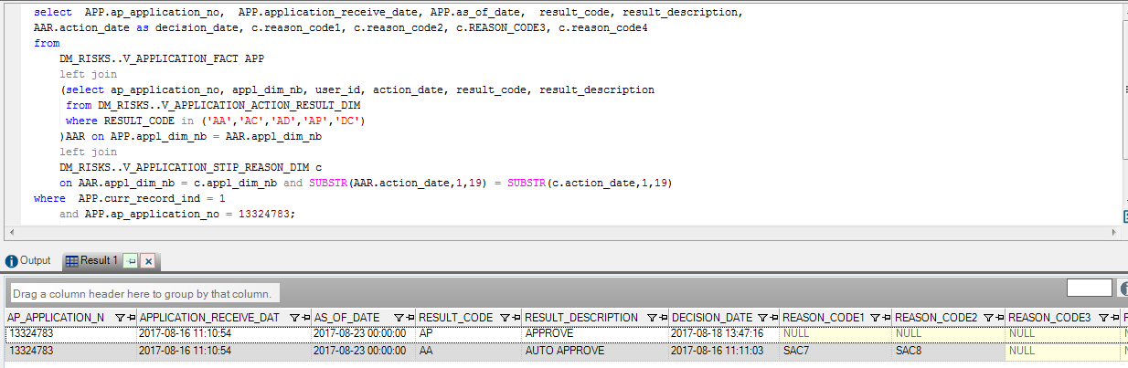
RIDE – Approval with Condition
Identifying applications that were approved with a condition
CONFIDENTIAL – INTERNAL USE ONLY

Slide 24
Appendix
FY17Q3

Slide 25
Auto Decisioning – The Future Roadmap
ID Verification – LexisNexis Cell Phone Gateway
Implementation – July 2017
Enhance existing LexisNexis InstantID functionality to include cell phone database in verification of identity (name, address, phone) parameters
Est. Volume Impact: 1.9~2.2% pts. ↑ in Auto Approvals
Approval with Conditions
Implementation – August 2017
Have the ability to auto decision applications that are currently sent for manual review due to a minor discrepancy in either one of the following parameters: Address, Name, SSN, and/or Phone Number
Est. Volume Impact: 2.9~3.3% pts. ↑ in Auto Approvals
CONFIDENTIAL – INTERNAL USE ONLY

Slide 26
Auto Decisioning – The Future Roadmap
Multiple Applications – Same Dealer
Est. Implementation – Jan’ 2018 (pending coord. w/ Fiserv)
Functionality to Auto decision the 2nd application from the same consumer and from same dealer. All subsequent applications queued for manual review
System to evaluate consumer(s)’ credit worthiness for single & both vehicles
Est. Volume Impact: 1.4~1.9% pts. ↑ in Auto Approvals
Multiple Applications – Different Dealer
Est. Implementation – Jan’2018 (pending coord. w/ Fiserv)
Functionality to Auto decision the 2nd application from the same consumer(s). All subsequent applications queued for manual review
System to evaluate consumer(s)’ credit worthiness for both vehicles only
Est. Volume Impact: 0.4~0.5% pts. ↑ in Auto Approvals
CONFIDENTIAL – INTERNAL USE ONLY

Slide 27
Auto Decisioning – The Future Roadmap
Alternate Deal Structures (ADS)
Est. Implementation – TBD
Systematically providing alternate (or counter offer) deal structures that are customized based on consumers’ credit worthiness
ADS provided to consumer/dealer would be optimized considering TFS’ risk appetite, pricing engine (pricing Excellence), and profitability
Business Solutions Scorecards
Est. Implementation – TBD
Quantitatively assess the credit worthiness of business applications
Est. Volume Impact: 2.5~3.0% of total applications
CONFIDENTIAL – INTERNAL USE ONLY

Slide 28
RIDE Consumer Data Dictionary
CONFIDENTIAL – INTERNAL USE ONLY

